Slide 1

Handwritten Digit Recognition using Neural Network
Presented by:
Hetvi Modi U22CS074
Megha Patel U22CS078
Yashanki Zala U22CS108
Boddu Kajol U22CS111
APRIL 2024
SVNIT SURAT

Slide 2

Problem Statement
Creating a neural network to classify handwritten digits from the MNIST dataset. Exploring different architectures to enhance accuracy. Showcasing the power of deep learning in image recognition.
SVNIT SURAT

Slide 3
Objective
To develop a neural network to recognize handwritten digits accurately from the MNIST dataset. Train on 28x28 pixel grayscale images to classify digits 0-9. Aim to preprocess data, train the model, and assess its performance for OCR and computer vision.
SVNIT SURAT

Slide 4
Assumption
It can recognise only single digit at a time
It can only recognise digits not other symbols
SVNIT SURAT

Slide 5
Agent Introduction
The learning model trained to recognize handwritten digits.
It utilizes neural network architecture to analyze images and predict the corresponding digit class.
Trained on the MNIST dataset, it learns patterns and features to distinguish between different digits.
PEAS:
Performance measure: Accuracy, Speed, Correctness of Output
Environment: MNIST dataset
Actuators: Display screen (output : digit label (0-9))
Sensors: Camera ( input: grayscale image )
SVNIT SURAT

Slide 6
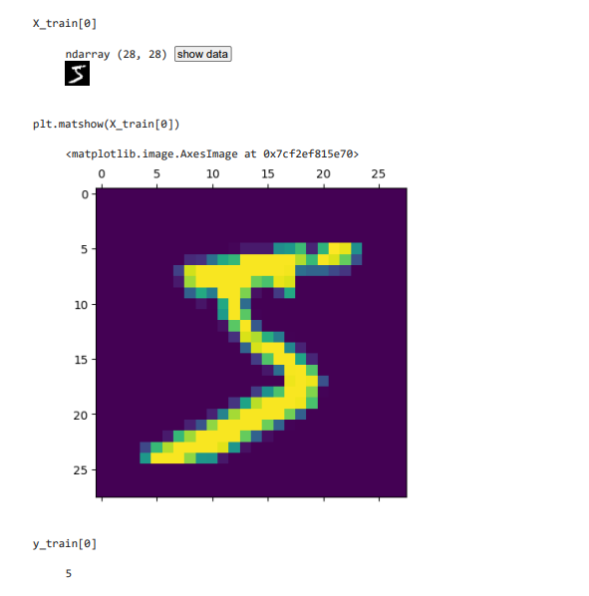
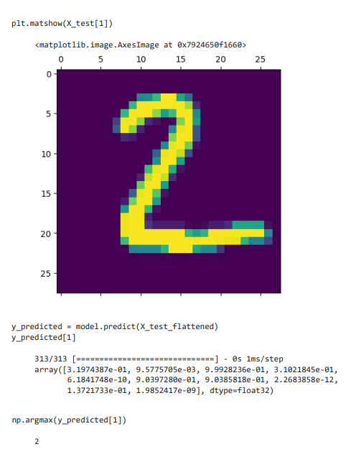
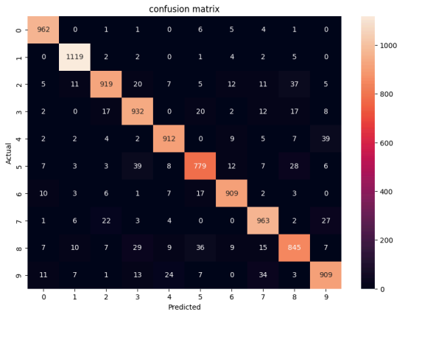
SVNIT SURAT

Slide 7
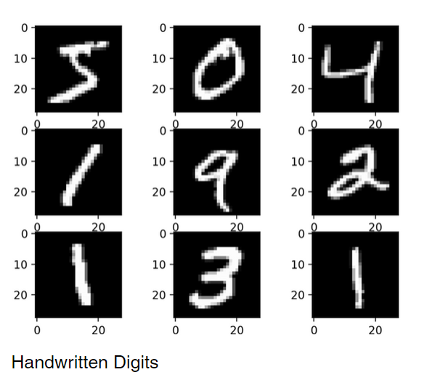
SVNIT SURAT

Slide 8
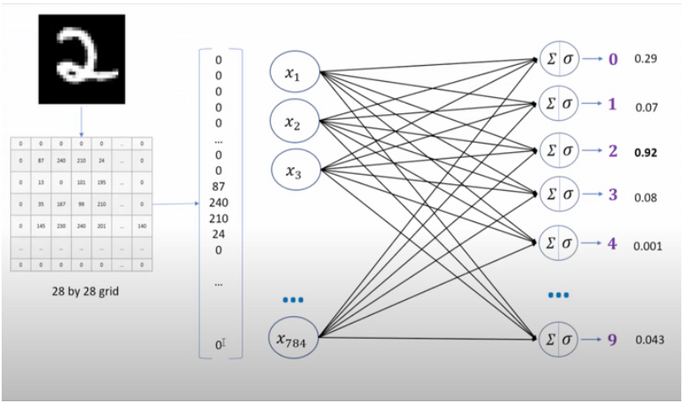
SVNIT SURAT

Slide 9

Working Video

Slide 10
AI Module Used
Module 2: Automated problem solving agent
2.1: Intelligent agent and environment
Module 8: Learning from examples
8.2: Perceptrons and Neural networks
SVNIT SURAT

Slide 11
Our Learnings
Understanding of image classification techniques: We learn how to build and train neural network models for image classification tasks.
Different python libraries: Understand different Python libraries like TensorFlow, Keras, NumPy and Matplotlib.
Data preprocessing techniques: We learn how to preprocess and prepare image data for training neural networks, including normalization and reshaping.
Model evaluation and optimization: Insights into evaluating model performance using metrics such as accuracy and confusion matrices, as well as techniques for optimizing model architecture and hyperparameters.
SVNIT SURAT

Slide 12
Conclusion
Successful implementation of handwritten digit recognition system using deep learning techniques.
Learning of data preprocessing techniques and model evaluation methods, essential for developing effective AI systems.
SVNIT SURAT

Slide 13
Future Work
Multi-Class Recognition: Extend recognition to alphabets (A-Z) alongside digits (0-9) using techniques like multi-label classification.
Recognition of Multiple Letters: Develop algorithms for detecting and segmenting individual letters within images, ensuring accurate recognition even in complex scenarios.
Snap-Like Features: Integrate real-time image processing and object detection to enable instant recognition of handwritten text from mobile device cameras.
SVNIT SURAT

